Slide 1
物件導向設計
Exception Handling
例外處理
授課教師:陳錫民
Email: hsiminc@fcu.edu.tw

Slide 2


Slide 3
Error Handling
In the ideal world, all errors would occur when your code is compiled. That won’t happen.
e.g. network is not reachable
Errors which occur when your code is running must be handled by some mechanism that
allows the detector of the error to pass information
to the recipient of the error
who will know how to deal with the error.

Slide 4
Procedural Error Handling
In procedural languages, error handling was usually by convention.
Programmers simply agreed on some standard way to report errors.
Usually a function returned a value which had to be checked by the caller
Not part of the language
Completely unenforceable
Programmers tended to ignore them
Checking all return values would result in unreadable code

Slide 5
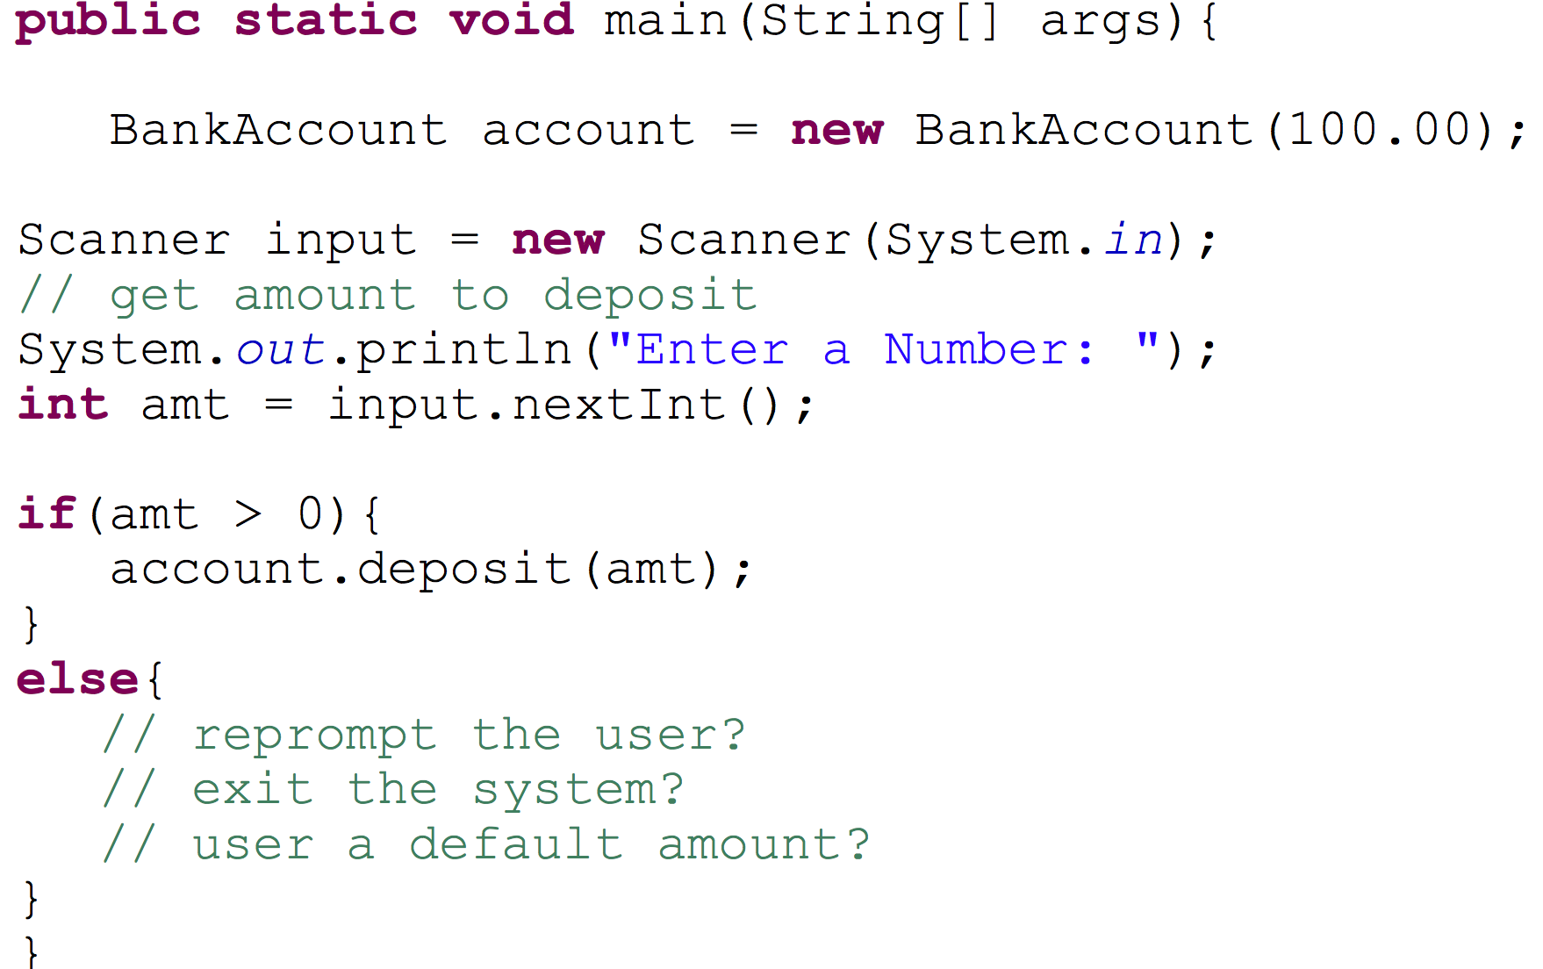
Bank Account Deposit Example

Slide 6
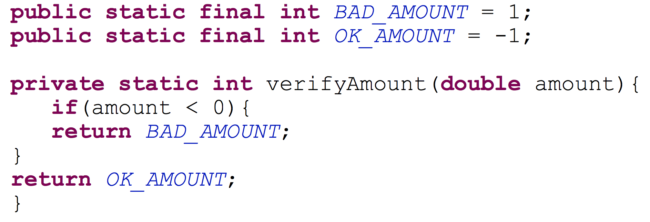
Bank Account Deposit Example
In a banking application written in a procedural approach,
we might write a function that verifies that the amount to deposit is acceptable.
This function returns an int which must be interpreted by the calling code.

Slide 7
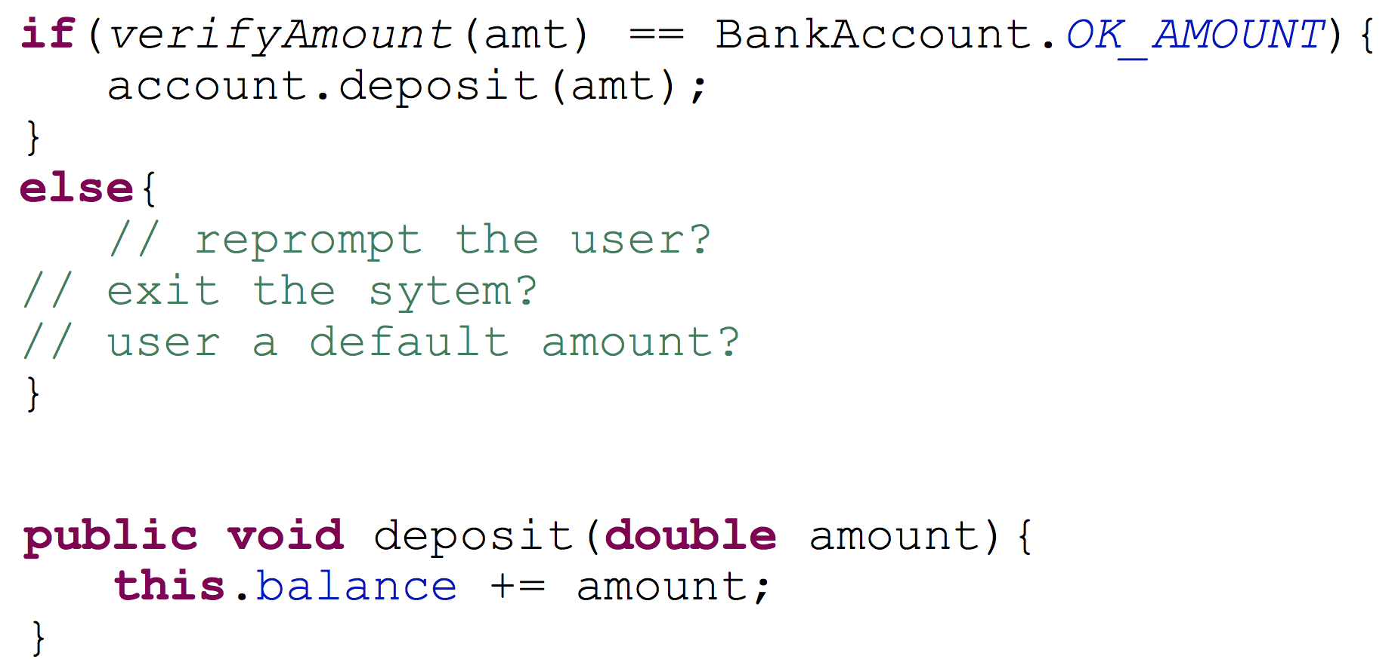
Errors By Convention
In main, the code calls the function and checks the return value

Slide 8
Better Error Handling
Separation of error detection from error handling
Class implementer detects the error
Class user decides what to do about the error
Exit the program
Output a message and continue the program
Retry the function that had the error
Ask the user what to do
Many other possibilities

Slide 9
Better Error Handling
Reduces complexity of code
Code that works when nothing unusual happens is separated from
the code that handles exceptional situations
Enforced by language

Slide 10
“Exceptional”
What’s an exceptional situation?
As defined in the Sun Java tutorial:
An exception is an event, which occurs during the execution of a program,
that disrupts the normal flow of the program's instructions.
The program encounters a situation it doesn’t know how to handle
Different than a “normal problem”
Program has enough information to know what to do next

Slide 11
Exception Handling
Removes error handling code from the code that caused the error
Makes it possible to catch all kinds of errors,
errors of a certain type,
or errors of related types
Is used in situations in which the system cannot recover.
Is used when the error will be dealt with by a different part of the program (i.e., different scope) from that which detected the error
Can be slow, but we don't care because errors occur very infrequently

Slide 12
Introduction to Exception Handling
Java library software (or programmer-defined code) provides a mechanism that signals when something unusual happens
This is called throwing an exception
In another place in the program, the programmer must provide code that deals with the exceptional case
This is called handling the exception

Slide 13
try-throw-catch
The basic way of handling exceptions in Java consists of the
try-throw-catch

Slide 14
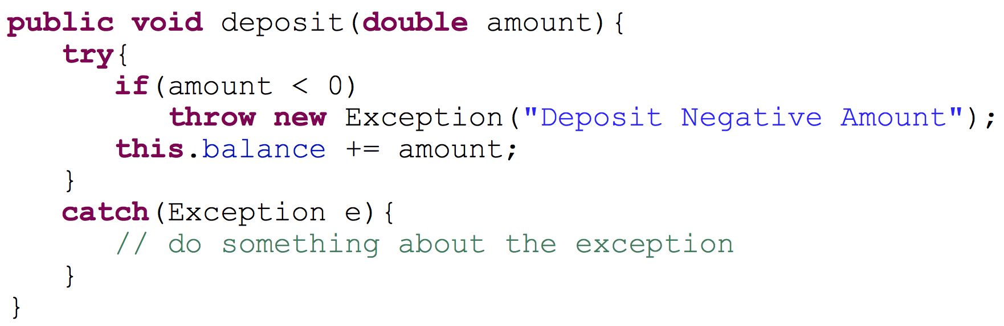
try-throw-catch example
This example is essentially a if-else expression, but to see the true separation of error detection from error handling we should look at how the try-throw-catch mechanism works

Slide 15
The try block
Code which calls a method that might throw an exception is placed inside a try block
The try block contains the code for the basic algorithm
It tells what to do when everything goes smoothly
It is called a try block because it "tries" to execute the case where all goes as planned
Code which handles the exception is placed into a catch block
catch block immediately follows the try block

Slide 16
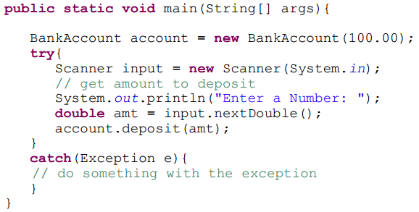
Better Bank Account Deposit Code

Slide 17
try-throw-catch Mechanism
When an exception is thrown, the execution of the surrounding try block is stopped
Normally, the flow of control is transferred to another portion of code known as the catch block
The value thrown is the argument to the throw operator, and is always an object of some exception class
The execution of a throw statement is called throwing an exception

Slide 18
try-throw-catch Mechanism
When an exception is thrown, the catch block begins execution
The catch block has one parameter
The exception object thrown is plugged in for the catch block parameter
The execution of the catch block is called catching the exception, or handling the exception
Whenever an exception is thrown, it should ultimately be handled (or caught) by some catch block

Slide 19
try-throw-catch Mechanism
The identifier e in the above catch block heading is called the catch block parameter
The catch block parameter does two things:
It specifies the type of thrown exception object that the catch block can catch
e.g., an Exception class object above
It provides a name (for the thrown object that is caught) on which it can operate in the catch block
Note: The identifier e is often used by convention, but any nonkeyword identifier can be used

Slide 20
try-throw-catch Mechanism
When a try block is executed, two things can happen:
No exception is thrown in the try block
The code in the try block is executed to the end of the block
The catch block(s) is (are) skipped
The execution continues with the code placed after the catch block(s)

Slide 21
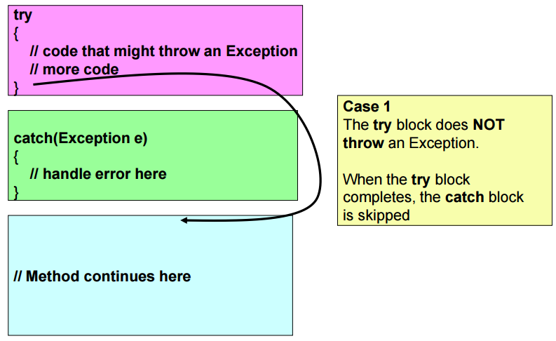
try-catch Control Flow

Slide 22
try-throw-catch Mechanism
An exception is thrown in the try block and caught in the catch block
The rest of the code in the try block is skipped
Control is transferred to a following catch block
The thrown object is plugged in for the catch block parameter
The code in the block is executed
The code that follows that catch block is executed

Slide 23
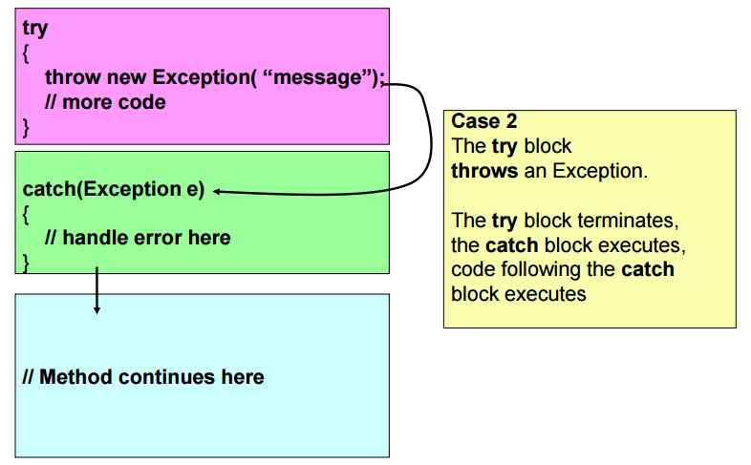
try-catch Control Flow

Slide 24
Exception Example
In many cases your own code doesn’t throw the exception, but instead it is thrown by an existing Java library
Example: Input an integer using nextInt()
What if the user doesn’t enter an integer?
The nextInt method throws an InputMismatchException

Slide 25
Exception Handling with the Scanner Class
If a user enters something other than a well-formed int value, an InputMismatchException will be thrown
Unless this exception is caught, the program will end with an error message
If the exception is caught, the catch block can give code for some alternative action, such as asking the user to reenter the input

Slide 26
The InputMismatchException
The InputMismatchException is in the standard Java package java.util
A program that refers to it must use an import statement, such as the following:
import java.util.InputMismatchException;
It is a descendent class of RuntimeException
Therefore, it is an unchecked exception and does not have to be caught in a catch block or declared in a throws clause
However, catching it in a catch block is allowed, and can sometimes be useful

Slide 27
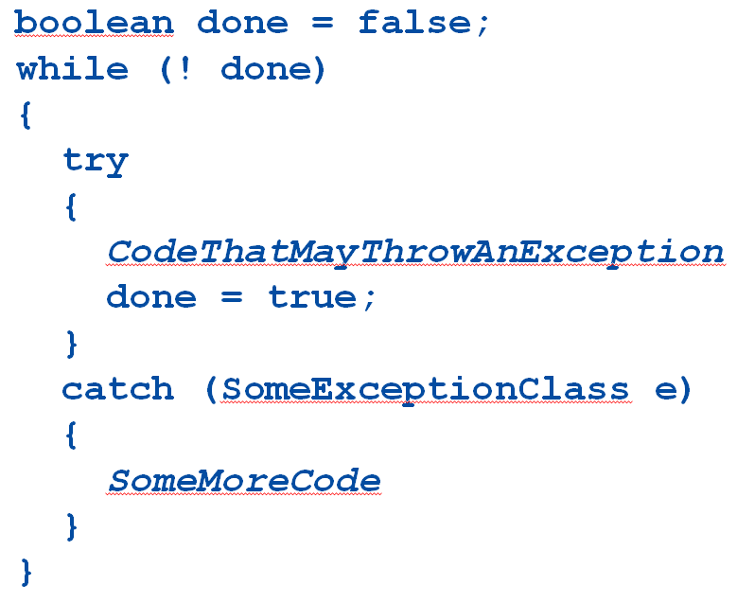
Tip: Exception Controlled Loops
Sometimes it is better to simply loop through an action again when an exception is thrown, as follows:

Slide 28
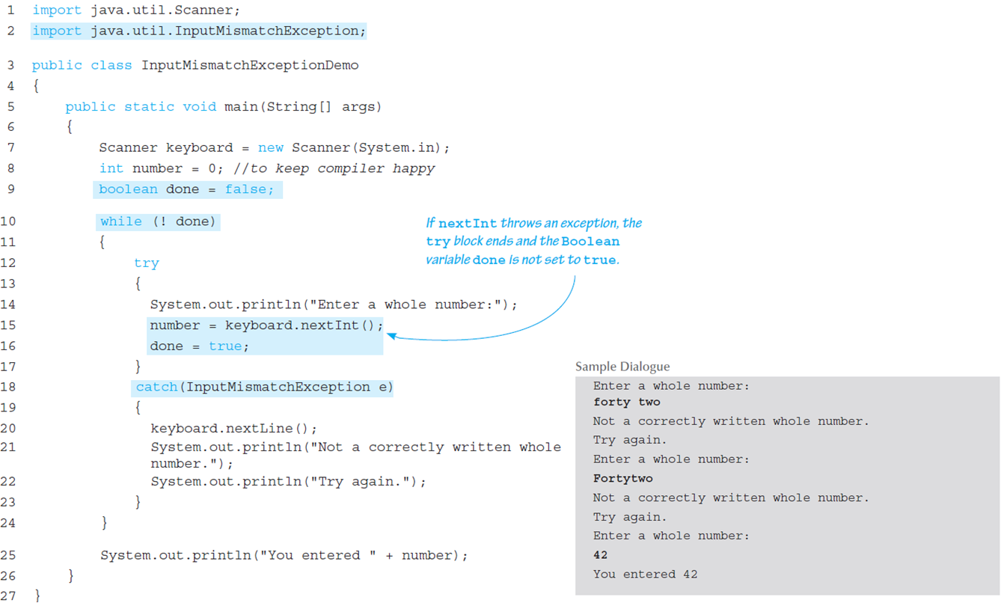
Exception Controlled Loop

Slide 29
Exception Classes
The Java language defines a basic Exception class
There are more exception classes in the standard Java libraries
New exception classes can be defined like any other class
All predefined exception classes have the following properties:
There is a constructor that takes a single argument of type String
The class has an accessor method getMessage that can recover the string given as an argument to the constructor when the exception object was created
All programmer-defined classes should have the same properties

Slide 30
Exception Classes from Standard Packages
The predefined exception class Exception is the root class for all exceptions
Every exception class is a descendent class of the class Exception
Although the Exception class can be used directly in a class or program, it is most often used to define a derived class
The class Exception is in the java.lang package, and so requires no import statement

Slide 31
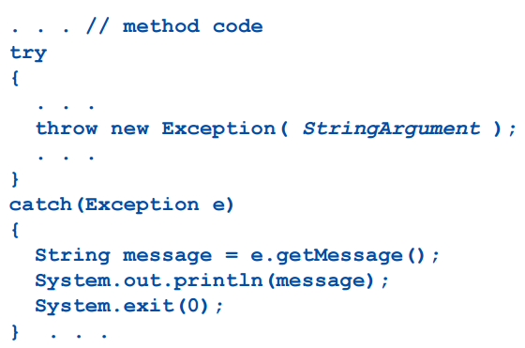
Using the getMessage Method

Slide 32
Using the getMessage Method
Every exception has a String instance variable that contains some message
This string typically identifies the reason for the exception
In the previous example, StringArgument is an argument to the Exception constructor
This is the string used for the value of the string instance variable of exception e
Therefore, the method call e.getMessage() returns this string

Slide 33
Defining Exception Classes
A throw statement can throw an exception object of any exception class
Instead of using a predefined class, exception classes can be programmer-defined
These can be tailored to carry the precise kinds of information needed in the catch block
A different type of exception can be defined to identify each different exceptional situation

Slide 34
Defining Exception Classes
Every exception class to be defined must be a derived class of some already defined exception class
It can be a derived class of any exception class in the standard Java libraries, or of any programmer defined exception class
Constructors are the most important members to define in an exception class
They must behave appropriately with respect to the variables and methods inherited from the base class
Often, there are NO other members, except those inherited from the base class

Slide 35
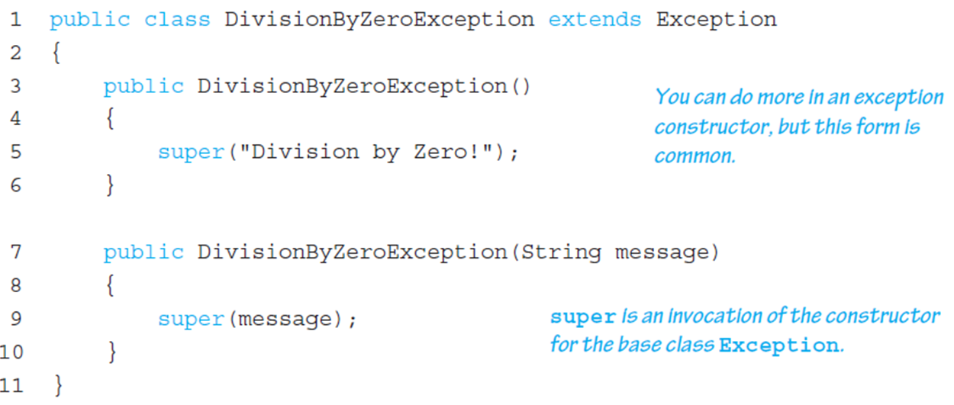
A Programmer-Defined Exception Class

Slide 36
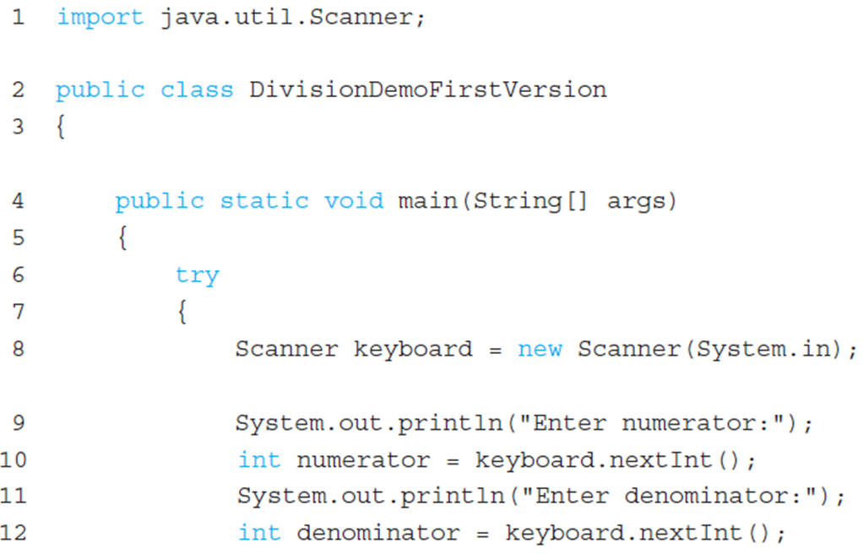
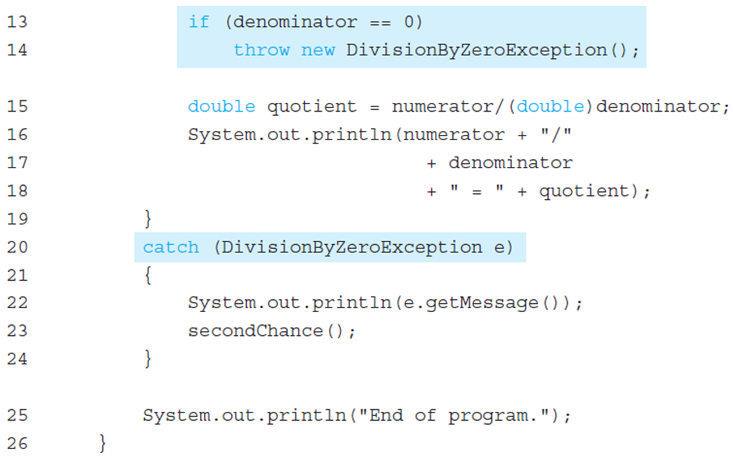
Using our own Exception Class

Slide 37
Tip: An Exception Class Can Carry a Message of Any Type: int Message
An exception class constructor can be defined that takes an argument of another type
It would stores its value in an instance variable
It would need to define accessor methods for this instance variable

Slide 38
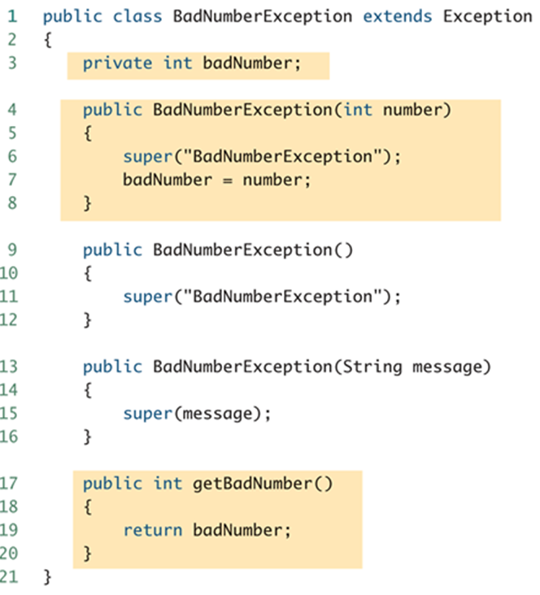
An Exception Class with an int Message

Slide 39
Exception Object Characteristics
The two most important things about an exception object are its type (i.e., exception class) and the message it carries
The message is sent along with the exception object as an instance variable
This message can be recovered with the accessor method getMessage, so that the catch block can use the message

Slide 40
Programmer-Defined Exception Class Guidelines
Exception classes may be programmer-defined, but every such class must be a derived class of an already existing exception class
The class Exception can be used as the base class, unless another exception class would be more suitable
At least two constructors should be defined, sometimes more
The exception class should allow for the fact that the method getMessage is inherited

Slide 41
Preserve getMessage
For all predefined exception classes, getMessage returns the string that is passed to its constructor as an argument
Or it will return a default string if no argument is used with the constructor
This behavior must be preserved in all programmer-defined exception class
A constructor must be included having a string parameter whose body begins with a call to super
The call to super must use the parameter as its argument
A no-argument constructor must also be included whose body begins with a call to super
This call to super must use a default string as its argument

Slide 42
Multiple catch Blocks
A try block can potentially throw any number of exception values, and they can be of differing types
In any one execution of a try block, at most one exception can be thrown
since a throw statement ends the execution of the try block
However, different types of exception values can be thrown on different executions of the try block

Slide 43
Multiple catch Blocks
Each catch block can only catch values of the exception class type given in the catch block heading
Different types of exceptions can be caught by placing more than one catch block after a try block
Any number of catch blocks can be included, but they must be placed in the correct order

Slide 44
Pitfall: Catch the More Specific Exception First
When catching multiple exceptions, the order of the catch blocks is important
When an exception is thrown in a try block, the catch blocks are examined in order
The first one that matches the type of the exception thrown is the one that is executed

Slide 45
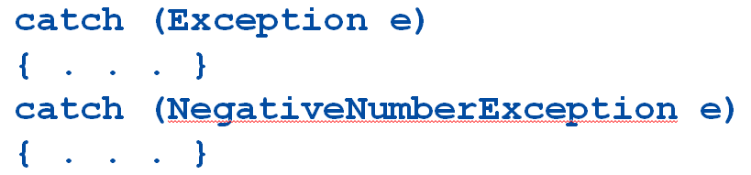
Pitfall: Catch the More Specific Exception First
Because a NegativeNumberException is a type of Exception, all NegativeNumberExceptions will be caught by the first catch block before ever reaching the second block
The catch block for NegativeNumberException will never be used!
For the correct ordering, simply reverse the two blocks

Slide 46
Throwing an Exception in a Method
Sometimes it makes sense to throw an exception in a method, but not catch it in the same method
Some programs that use a method should just end if an exception is thrown, and other programs should do something else
In this case, the method itself would not include try and catch blocks
However, it would have to include a throws clause

Slide 47
Declaring Exceptions in a throws Clause
If a method can throw an exception but does not catch it, it must provide a warning
This warning is called a throws clause
The process of including an exception class in a throws clause is called declaring the exception
throws AnException //throws clause
The following states that an invocation of aMethod could throw AnException
public void aMethod() throws AnException

Slide 48
Declaring Exceptions in a throws Clause
If a method can throw more than one type of exception, then separate the exception types by commas
public void aMethod() throws AnException, AnotherException
If a method throws an exception and does not catch it, then the method invocation ends immediately

Slide 49
The Catch or Declare Rule
Most ordinary exceptions that might be thrown within a method must be accounted for in one of two ways:
The code that can throw an exception is placed within a try block, and the possible exception is caught in a catch block within the same method
The possible exception can be declared at the start of the method definition by placing the exception class name in a throws clause

Slide 50
The Catch or Declare Rule
The first technique handles an exception in a catch block
The second technique is a way to shift the exception handling responsibility to the method that invoked the exception throwing method
The invoking method must handle the exception, unless it too uses the same technique to "pass the buck"
Ultimately, every exception that is thrown should eventually be caught by a catch block in some method that does not just declare the exception class in a throws clause

Slide 51
The Catch or Declare Rule
In any one method, both techniques can be mixed
Some exceptions may be caught, and others may be declared in a throws clause
However, these techniques must be used consistently with a given exception
If an exception is not declared, then it must be handled within the method
If an exception is declared, then the responsibility for handling it is shifted to some other calling method
Note that if a method definition encloses an invocation of a second method, and the second method can throw an exception and does not catch it, then the first method must catch or declare it

Slide 52
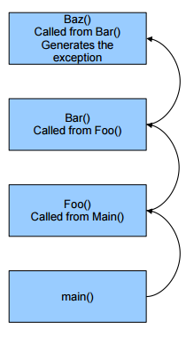
Where does it start?
Regular modular programming will
cause the call stack to grow.
Each frame of the stack will execute a
series of statements that will
eventually lead to the program to
terminate successfully.
Any time an Exception is generated
the series of operations that would
normally occur in sequential ordering
is halted at that statement.

Slide 53
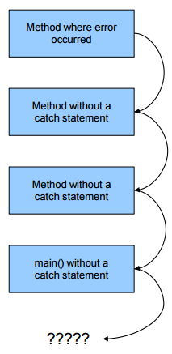
Why does my program crash?
The exception will be generated in a method.
Throw will throw the Exception Object
down the stack to a catch block.
When no catch block is present in
the previous stack frame, it thrown
down until it is caught.
If nothing catches that exception,
your program will crash.

Slide 54
Checked and Unchecked Exceptions
Exceptions that are subject to the catch or declare rule are called checked exceptions
The compiler checks to see if they are accounted for with either a catch block or a throws clause
The classes Throwable, Exception, and all descendants of the class Exception are checked exceptions
All other exceptions are unchecked exceptions
The class Error and all its descendant classes are called error classes
Error classes are not subject to the Catch or Declare Rule

Slide 55
Exceptions to the Catch or Declare Rule
Checked exceptions must follow the Catch or Declare Rule
Programs in which these exceptions can be thrown will not compile until they are handled properly
Unchecked exceptions are exempt from the Catch or Declare Rule
Programs in which these exceptions are thrown simply need to be corrected, as they result from some sort of error

Slide 56
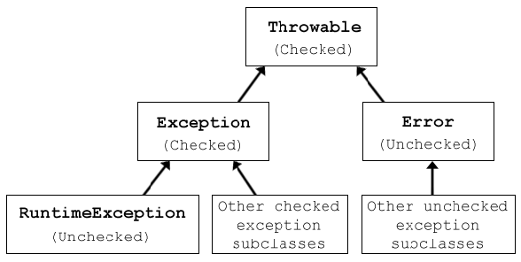
Hierarchy of Throwable Objects

Slide 57
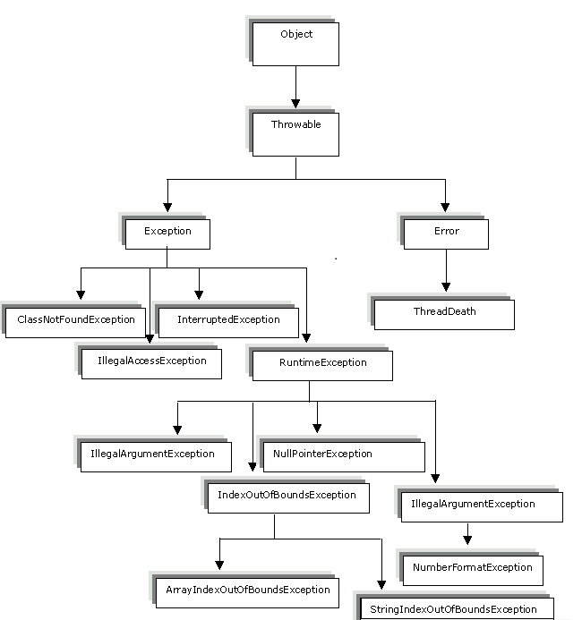
Hierarchy of Throwable Objects

Slide 58
The throws Clause in Derived Classes
When a method in a derived class is overridden, it should have the same exception classes listed in its throws clause that it had in the base class
Or it should have a subset of them
A derived class may not add any exceptions to the throws clause
But it can delete some

Slide 59
Why does my program crash?
If every method up to and including the main method simply includes a throw an exception, that exception may be thrown but never caught
In a GUI program (i.e., a program with a windowing interface), nothing happens
but the user may be left in an unexplained situation, and the program may be no longer be reliable
In non-GUI programs, this causes the program to terminate with an error message giving the name of the exception class
Every well-written program should eventually catch every exception by a catch block in some method

Slide 60
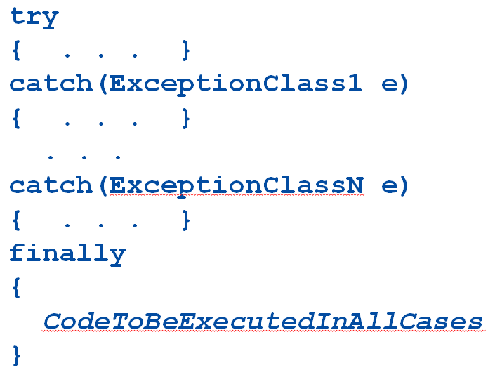
The finally Block
The finally block contains code to be executed whether or not an exception is thrown in a try block
If it is used, a finally block is placed after a try block and its following catch blocks

Slide 61
The finally Block
If the try-catch-finally blocks are inside a method definition, there are three possibilities when the code is run:
The try block runs to the end, no exception is thrown, and the finally block is executed
An exception is thrown in the try block, caught in one of the catch blocks, and the finally block is executed
An exception is thrown in the try block, there is no matching catch block in the method, the finally block is executed, and then the method invocation ends and the exception object is thrown to the enclosing method

Slide 62


